Slide 1
Assessing consistency of (single-cell) unsupervised multi-modal methods
Michael Love @mikelove
Dept. Biostatistics
Dept. Genetics UNC-Chapel Hill
bit.ly/scMultiModalAssess
June 18, 2020

Slide 2
Outline
My lab is interested in unsupervised multi-modal methods
Common variation over samples from 2 or more assays
(Gave this talk three times now, it is rare that bio/genetics people are aware of these)
Mostly we run existing methods like Sparse mCCA, MOFA, ...
Datasets: Pickrell (n = ~60), UNC Crohn’s data (n= ~100), TCGA breast cancer (n = ~500), MESA/TopMed (n > 1,000). And single cell; SMART-seq, scNMT-seq
Typically: mRNA, chromatin accessibility, (methylation, miRNA, somatic CNV, proteomics)
First, our 2019 evaluation of existing methods on bulk data
Second, looking at MOFA+ on SNARE-seq and scNMT-seq

Slide 3
Canonical correlation
CCA review in the beginning of Witten and Tibshirani 2009:
Compare to PCA:

Slide 4
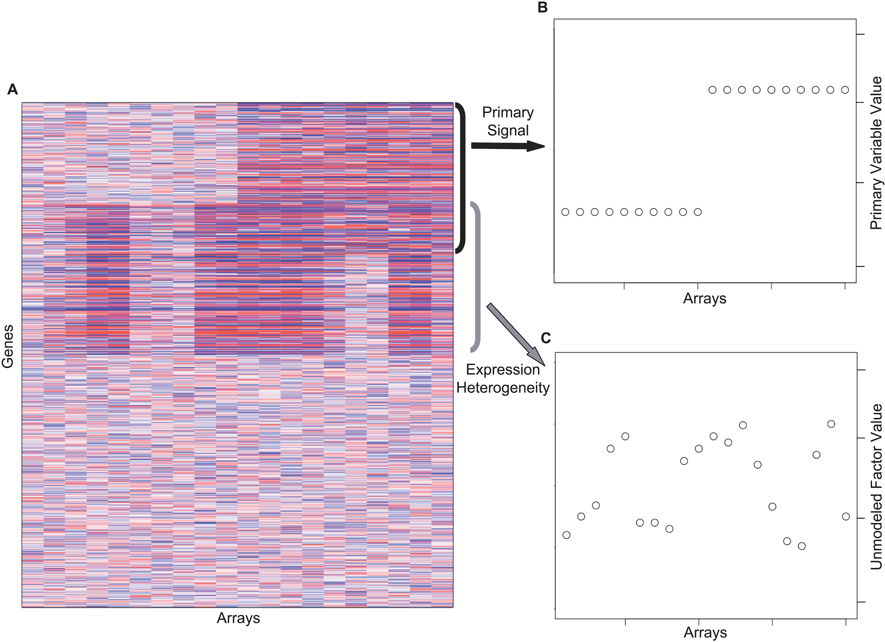
Why multi-modal methods interesting for multi-omics
Unwanted variation won’t be shared:
Except for extraction, study phase, etc.
✔
genes
proteins
✘
Won’t be shared
methyl
chromatin
Leek & Storey, “Capturing Heterogeneity in Gene Expression Studies by Surrogate Variable Analysis” 2007

Slide 5
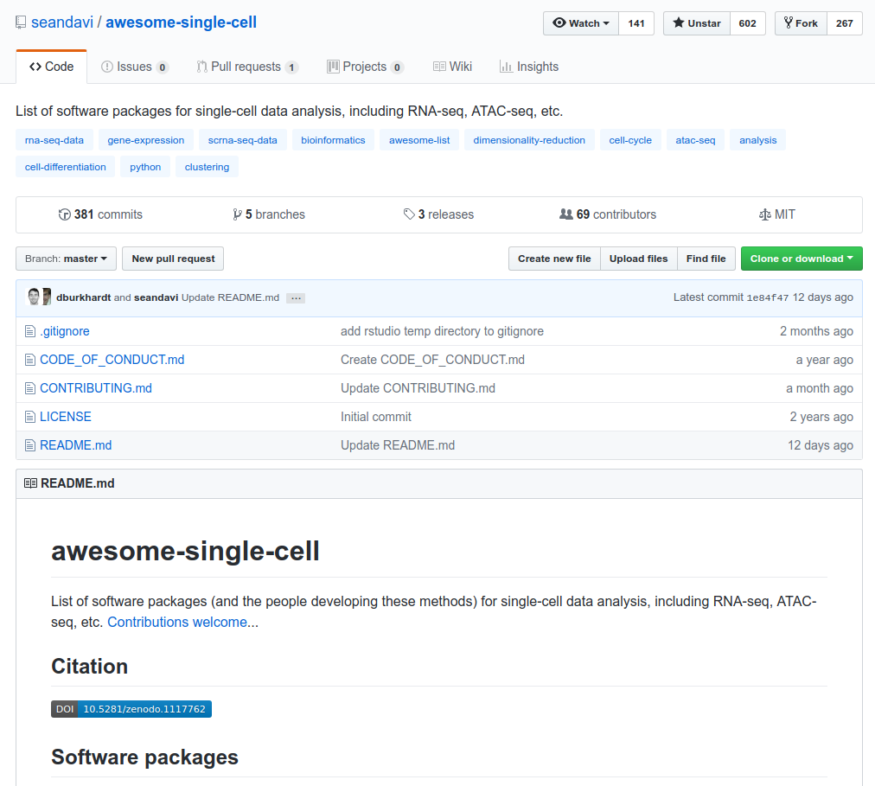
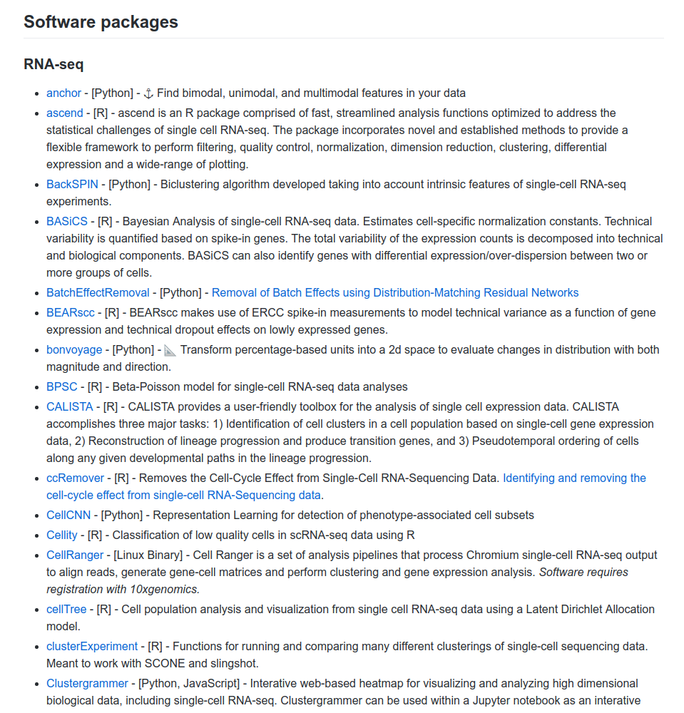
Modeled on the awesome-single-cell repository...

Slide 6
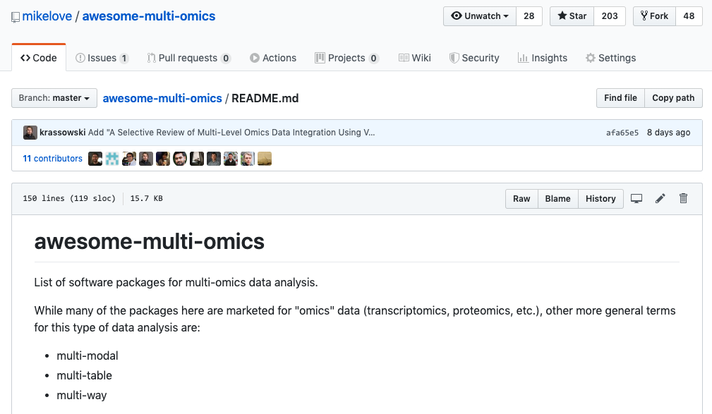
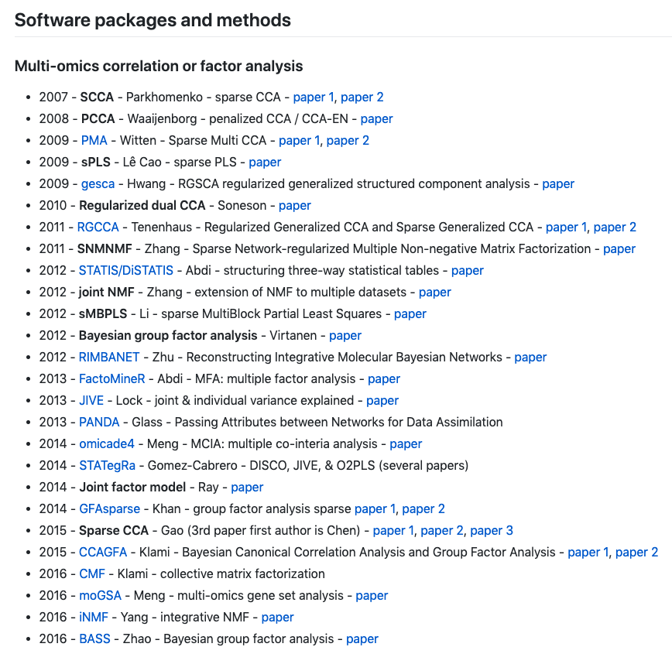
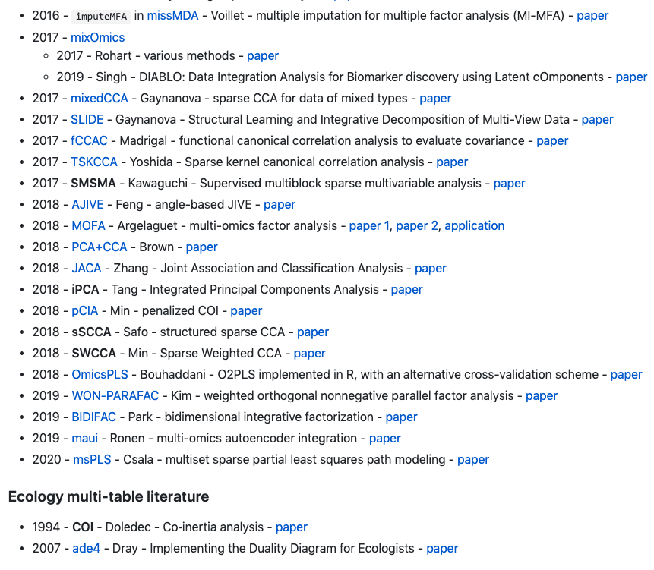
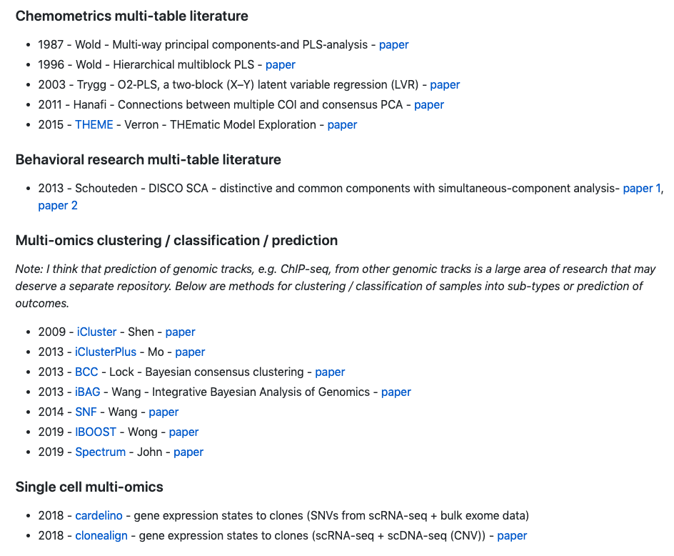
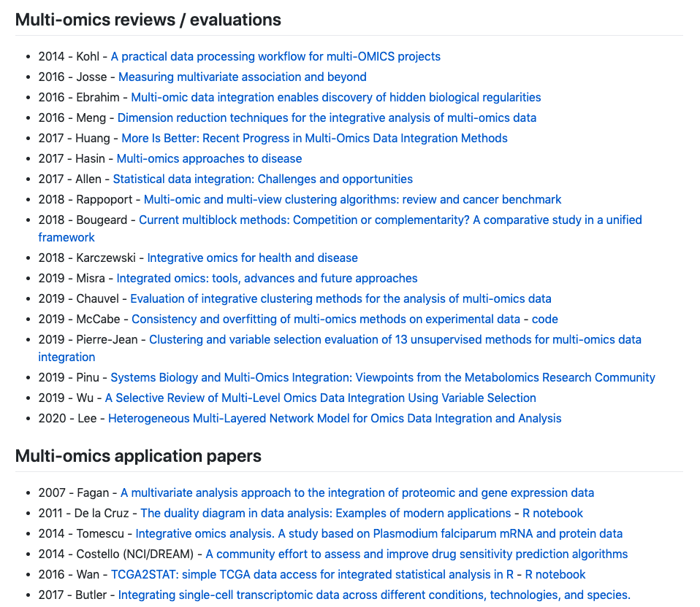
Now awesome-multi-omics, contributions welcome!

Slide 7
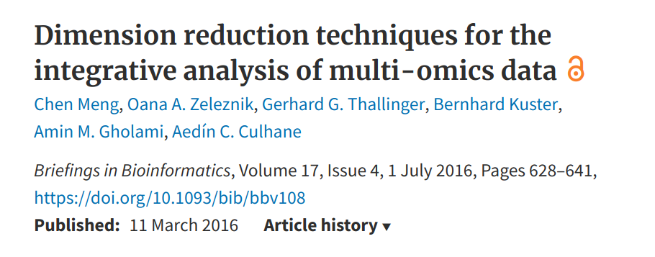
Where to start?
This is a useful review from 2016:
Another review (a microbiome application): Sankaran & Holmes (2019) https://doi.org/10.3389/fgene.2019.00627

Slide 8
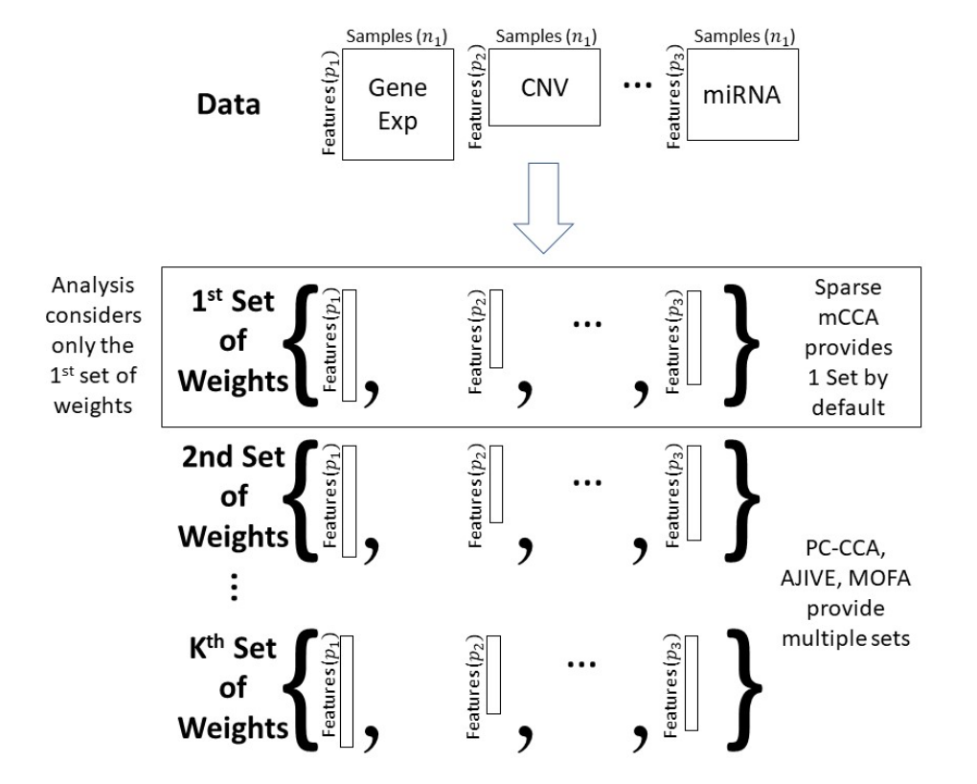
~2018: How to evaluate all these multi-modal methods?

Slide 9
We compared three methods… we should have used more
Sparse mCCA Witten and Tibshirani (2009)
Permutation-based penalty with objective:
AJIVE - Angle-based Joint and Individual Variation Explained - Feng et al (2018) (1) Truncated SVD of each matrix (2) SVD of the stacked row* basis matrices, with joint threshold defined by perturbation theory (3) “joint” and “individual” variation: projection of the joint row* space and orthogonal complements
* row basis = vector along samples
MOFA - Multi-Omics Factor Analysis - Argelaguet et al (2018)
X_{i} = Z B_{i} + ε_{i}
Z: a n x k matrix of latent factors (columns)
B_{i}: a k x p_{i} matrix of weights (rows) mapping to the original data
Form of ε_{i} depends on data type. Missingness allowed
Matrix-, factor-, and feature-level sparsity (ARD, and spike-and-slab priors)
Variational Bayes inference framework

Slide 10
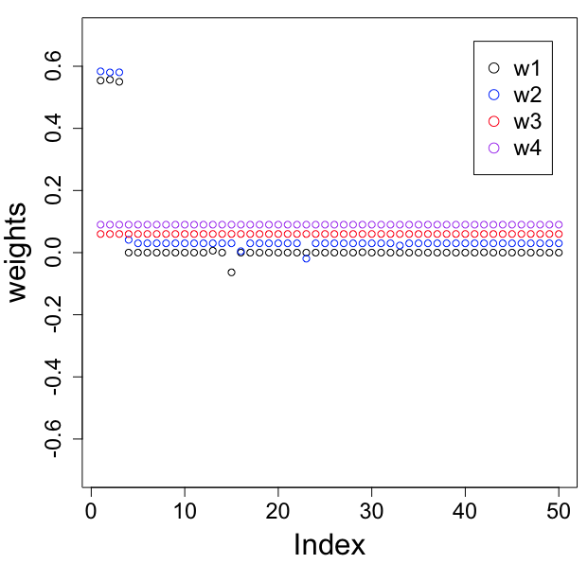
Strict pre-processing required
Consider, n=300 x p=1000 data matrices: X₁ = ε₁, X₂ = ε₂, X₃ = ε₃, X₄ = ε₄
X₁[1, 1-3] ← 100
X₂[1, 1-3] ← 100
Spike in an outlier across 3 features,
in 2 out of 4 data matrices. Outlier is the same sample (first one of 300)
Again and again, we have seen that outliers and scaling/transformation can drive the solution… be careful and consider these details.

Slide 11
How can we group and evaluate methods
From McCabe 2019
Certain methods, such as iCluster+ and Similarity Network Fusion (SNF) classify samples into groups [tumor subtypes].
Other methods determine which features or biological processes contribute to the common variation across data types, as well as the magnitude of the relationships.
By multiplying the estimated weights by the observed values of each data type, we obtain contributions for each sample and data type.

Slide 12
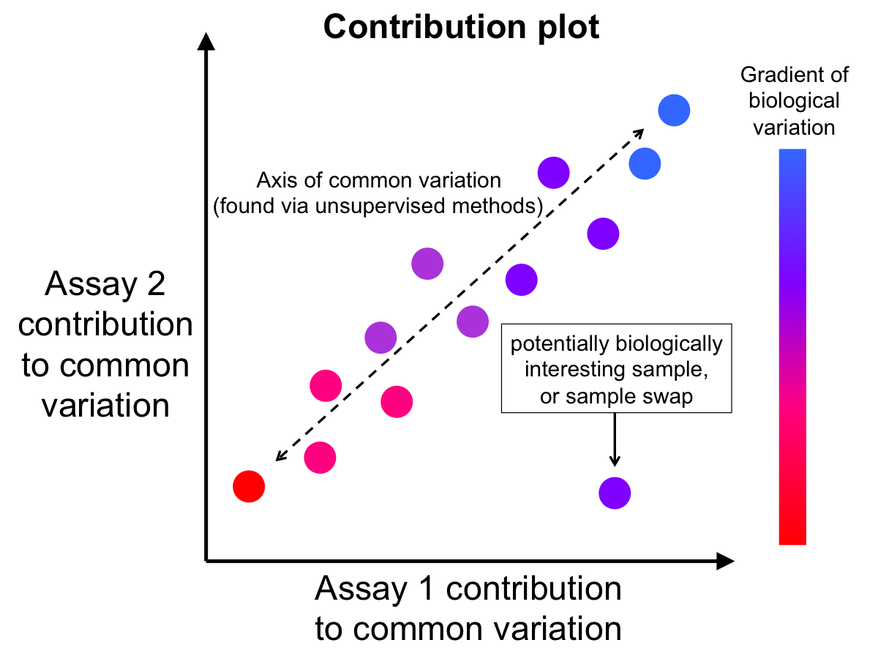
(X₂w₂)
(X₁w₁)

Slide 13
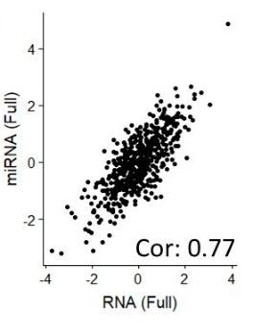
PC-CCA finds ⍴=0.77 across mRNA and miRNA (n=558)

Slide 14
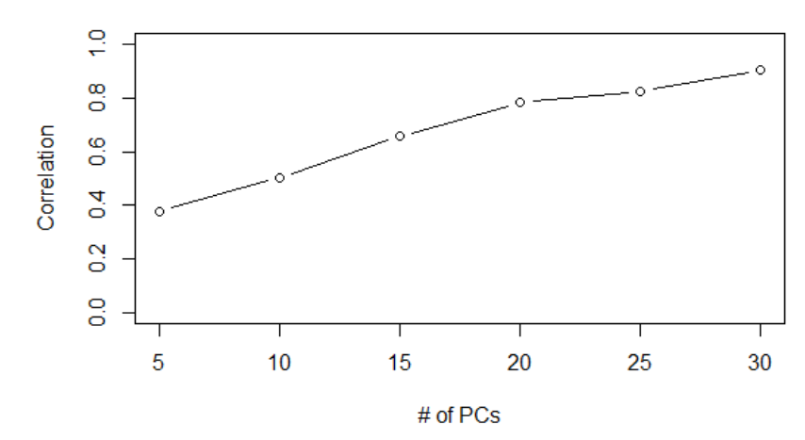
We (also) noticed overfitting was possible
Null data: 100 samples, 5000 features, all N(0,1) data

Slide 15
PC-CCA finds ⍴=0.77 across mRNA and miRNA (n=558)
Assay #2 had sample order permuted

Slide 16
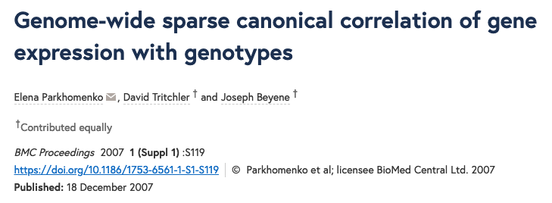
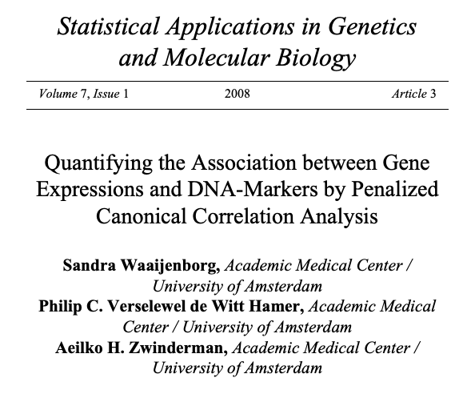
Correlation in the contribution plot
We find a high correlation in the contribution plot (i.e. the objective)
Now what? Is this real? Will it generalize?
“We evaluated the performance of SCCA using the leave-one-out cross-validation (LOOCV) analysis, treating a pedigree as one unit.”
“The optimal regularization parameters are chosen by cross-validation.”
“
.”
Just a few examples here, I’ve started compiling a more systematic literature in Gdocs… 1993 seems the first leave-one-out CV application for CCA.

Slide 17
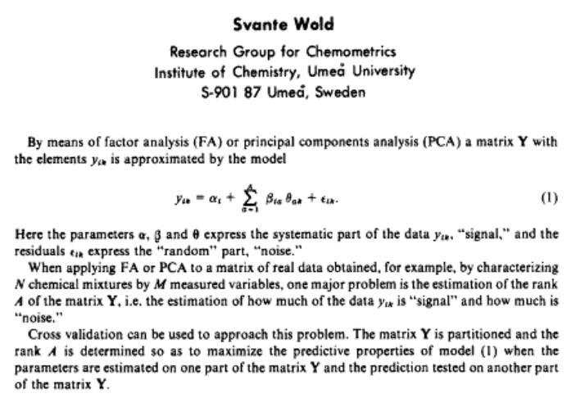
From chemometrics: Svante Wold (1978)
Cross-Validatory Estimation of the Number of Components in Factor and Principal Components Models

Slide 18
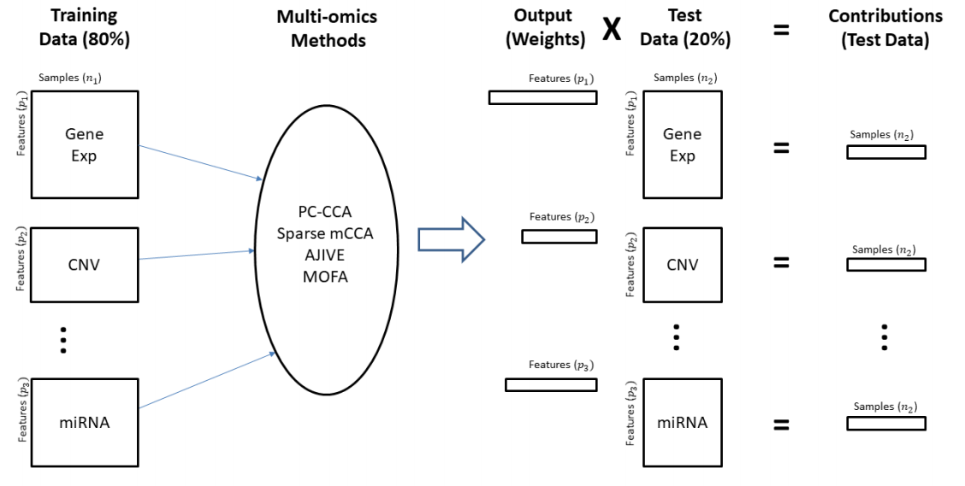
Evaluate methods using a CV framework
There are many more methods that we should have considered… e.g. COI/CIA, PLS, GFA

Slide 19
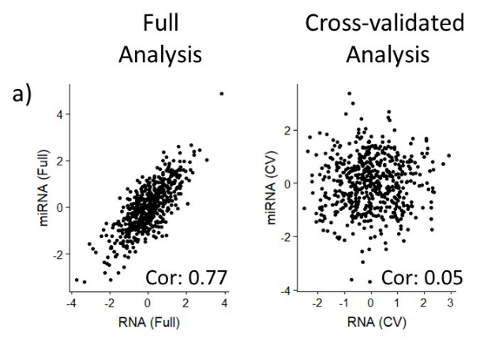
PC-CCA, overfitting on permuted data

Slide 20
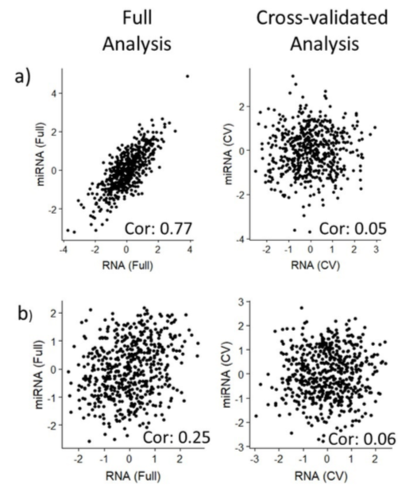
Other methods not overfitting as much on permuted
PC-CCA
Sparse mCCA

Slide 21
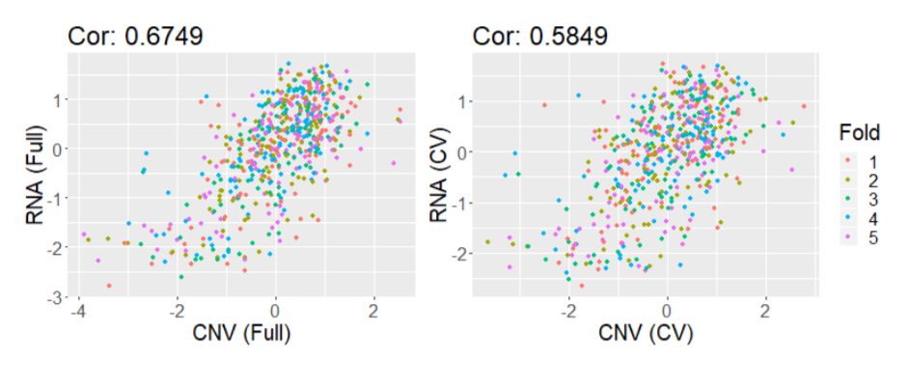
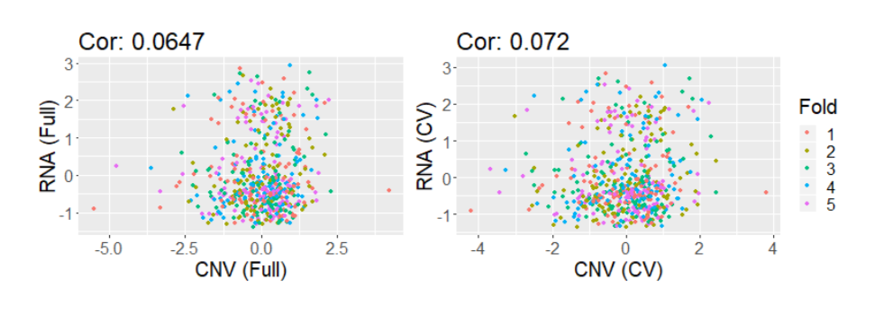
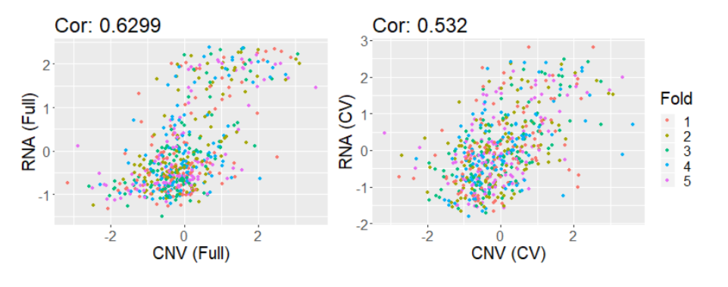
On a large TCGA-BC dataset (n=558) - RNA, miRNA, CNV
Sparse mCCA
AJIVE
MOFA

Slide 22
On a large TCGA-BC dataset (n=558) - RNA, miRNA, CNV
Sparse mCCA
AJIVE
MOFA

Slide 23
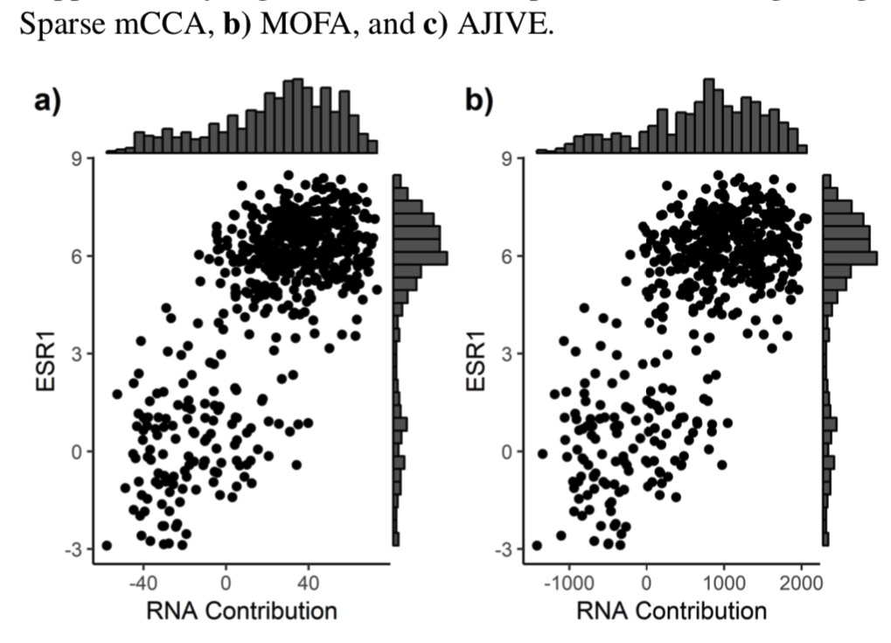
What does the first factor represent here
a)

Slide 24
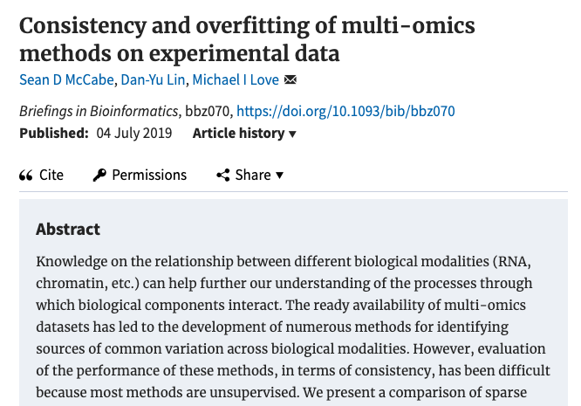
Multi-omics bulk assessment

Slide 25
Dealing with multiple solutions, identifiability
Argelaguet 2019 - “Single cell multi-omics profiling reveals a hierarchical epigenetic landscape during mammalian germ layer specification”

Slide 26
Multiple starts vs. CV
Running with multiple starts is a good check
But we also like cross-validation: assess the objective (e.g. correlation, or likelihood) of trained model on held-out samples/cells
Still: need to match or perform "registration" across runs or folds, because the factor label changes across runs or folds. E.g. CCA, STATIS, "BNO" (as Susan Holmes just discussed for PCA)

Slide 27
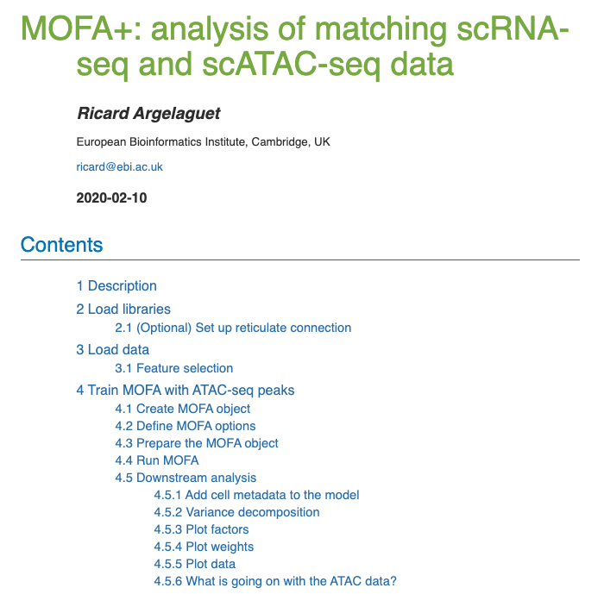
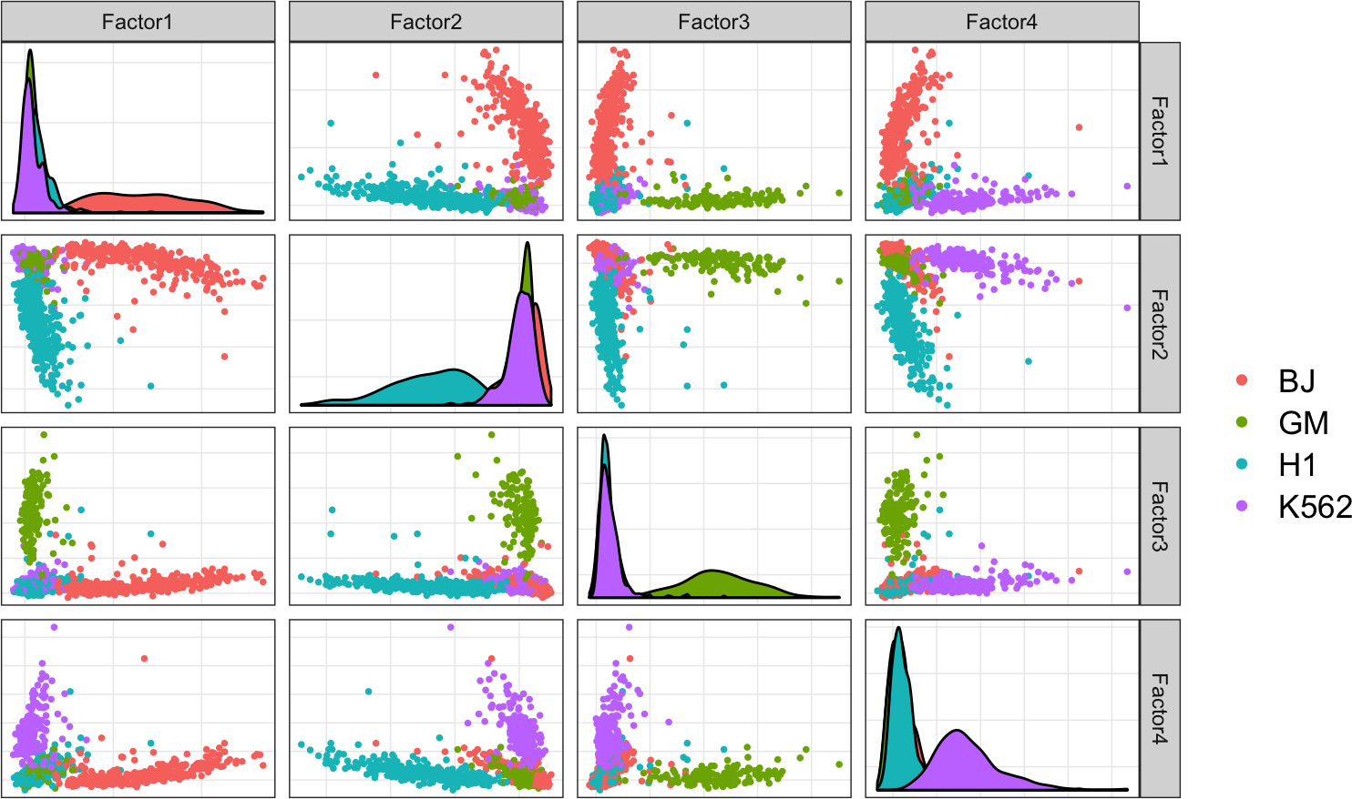
Single cell CV analyses
SNARE-seq and scNMT-seq data, from MOFA+ vignettes

Slide 28
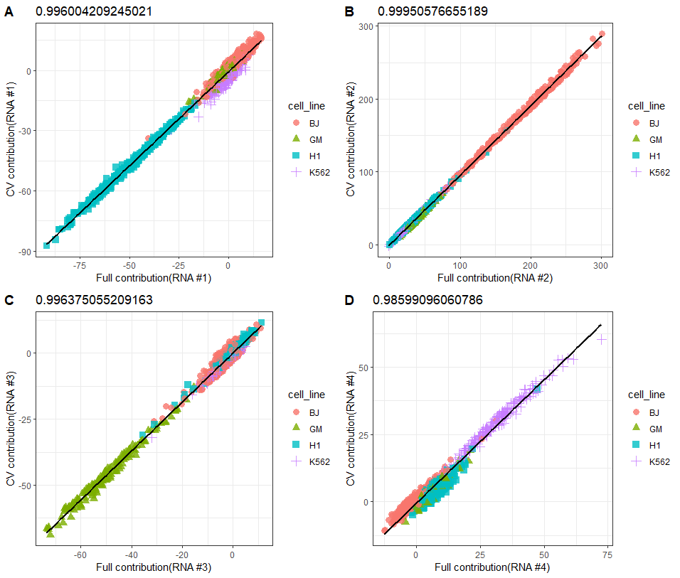
Consistency in held out data (expect strong)
We call these “comparison plots”: CV contributions over the contributions from the full data, for scRNA-seq.
Single cell CV analyses from Wancen Mu (UNC)

Slide 29
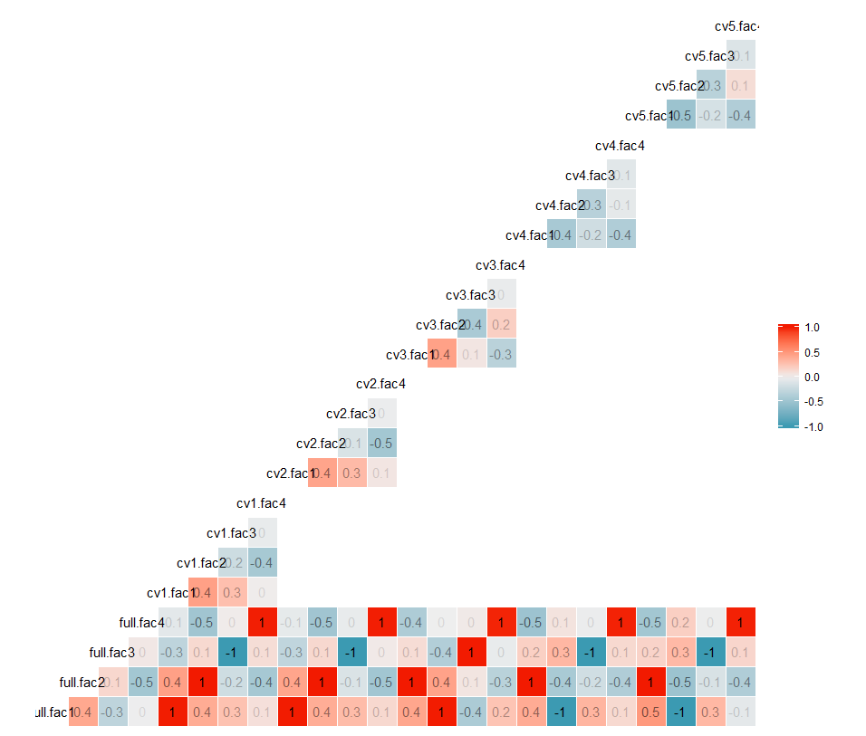
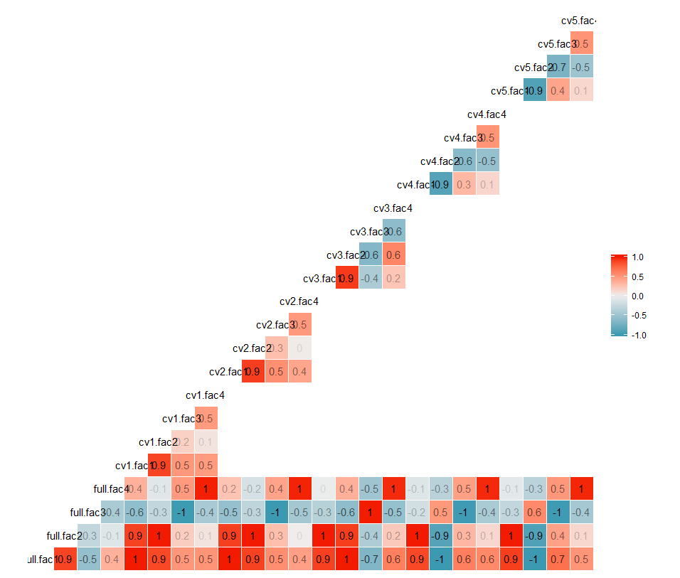
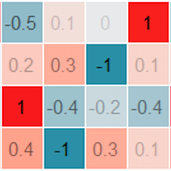
To get this consistency requires factor matching
scRNA
scATAC
Factor matching across folds is less trivial in this case
Not always orthogonal

Slide 30
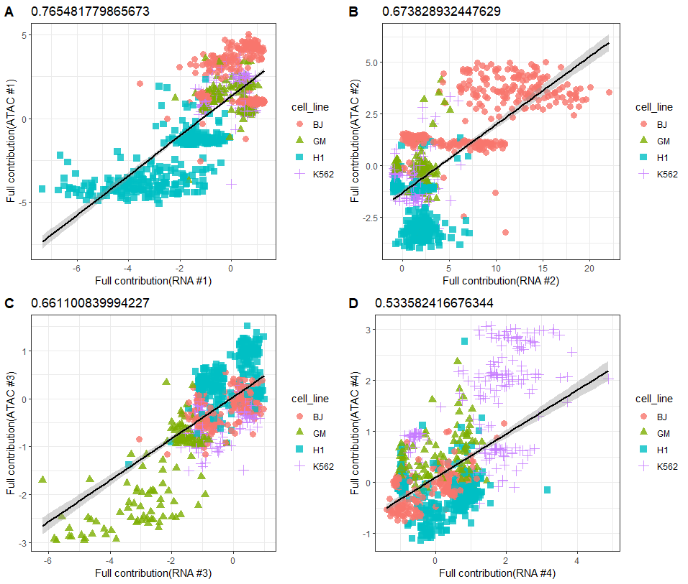
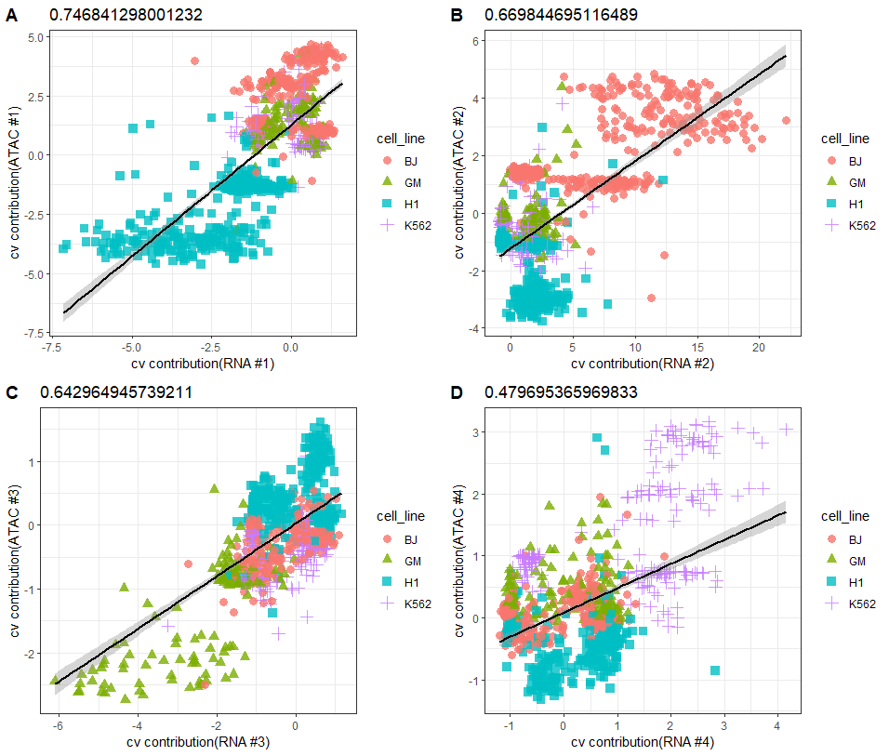
“Contribution plots”: scATAC (25 topics) ~ scRNA
Full dataset
Cross-validated
#1
#2
#1
#2
Discreteness from scATAC despite LDA dim. reduction
#3
#4
#3
#4

Slide 31
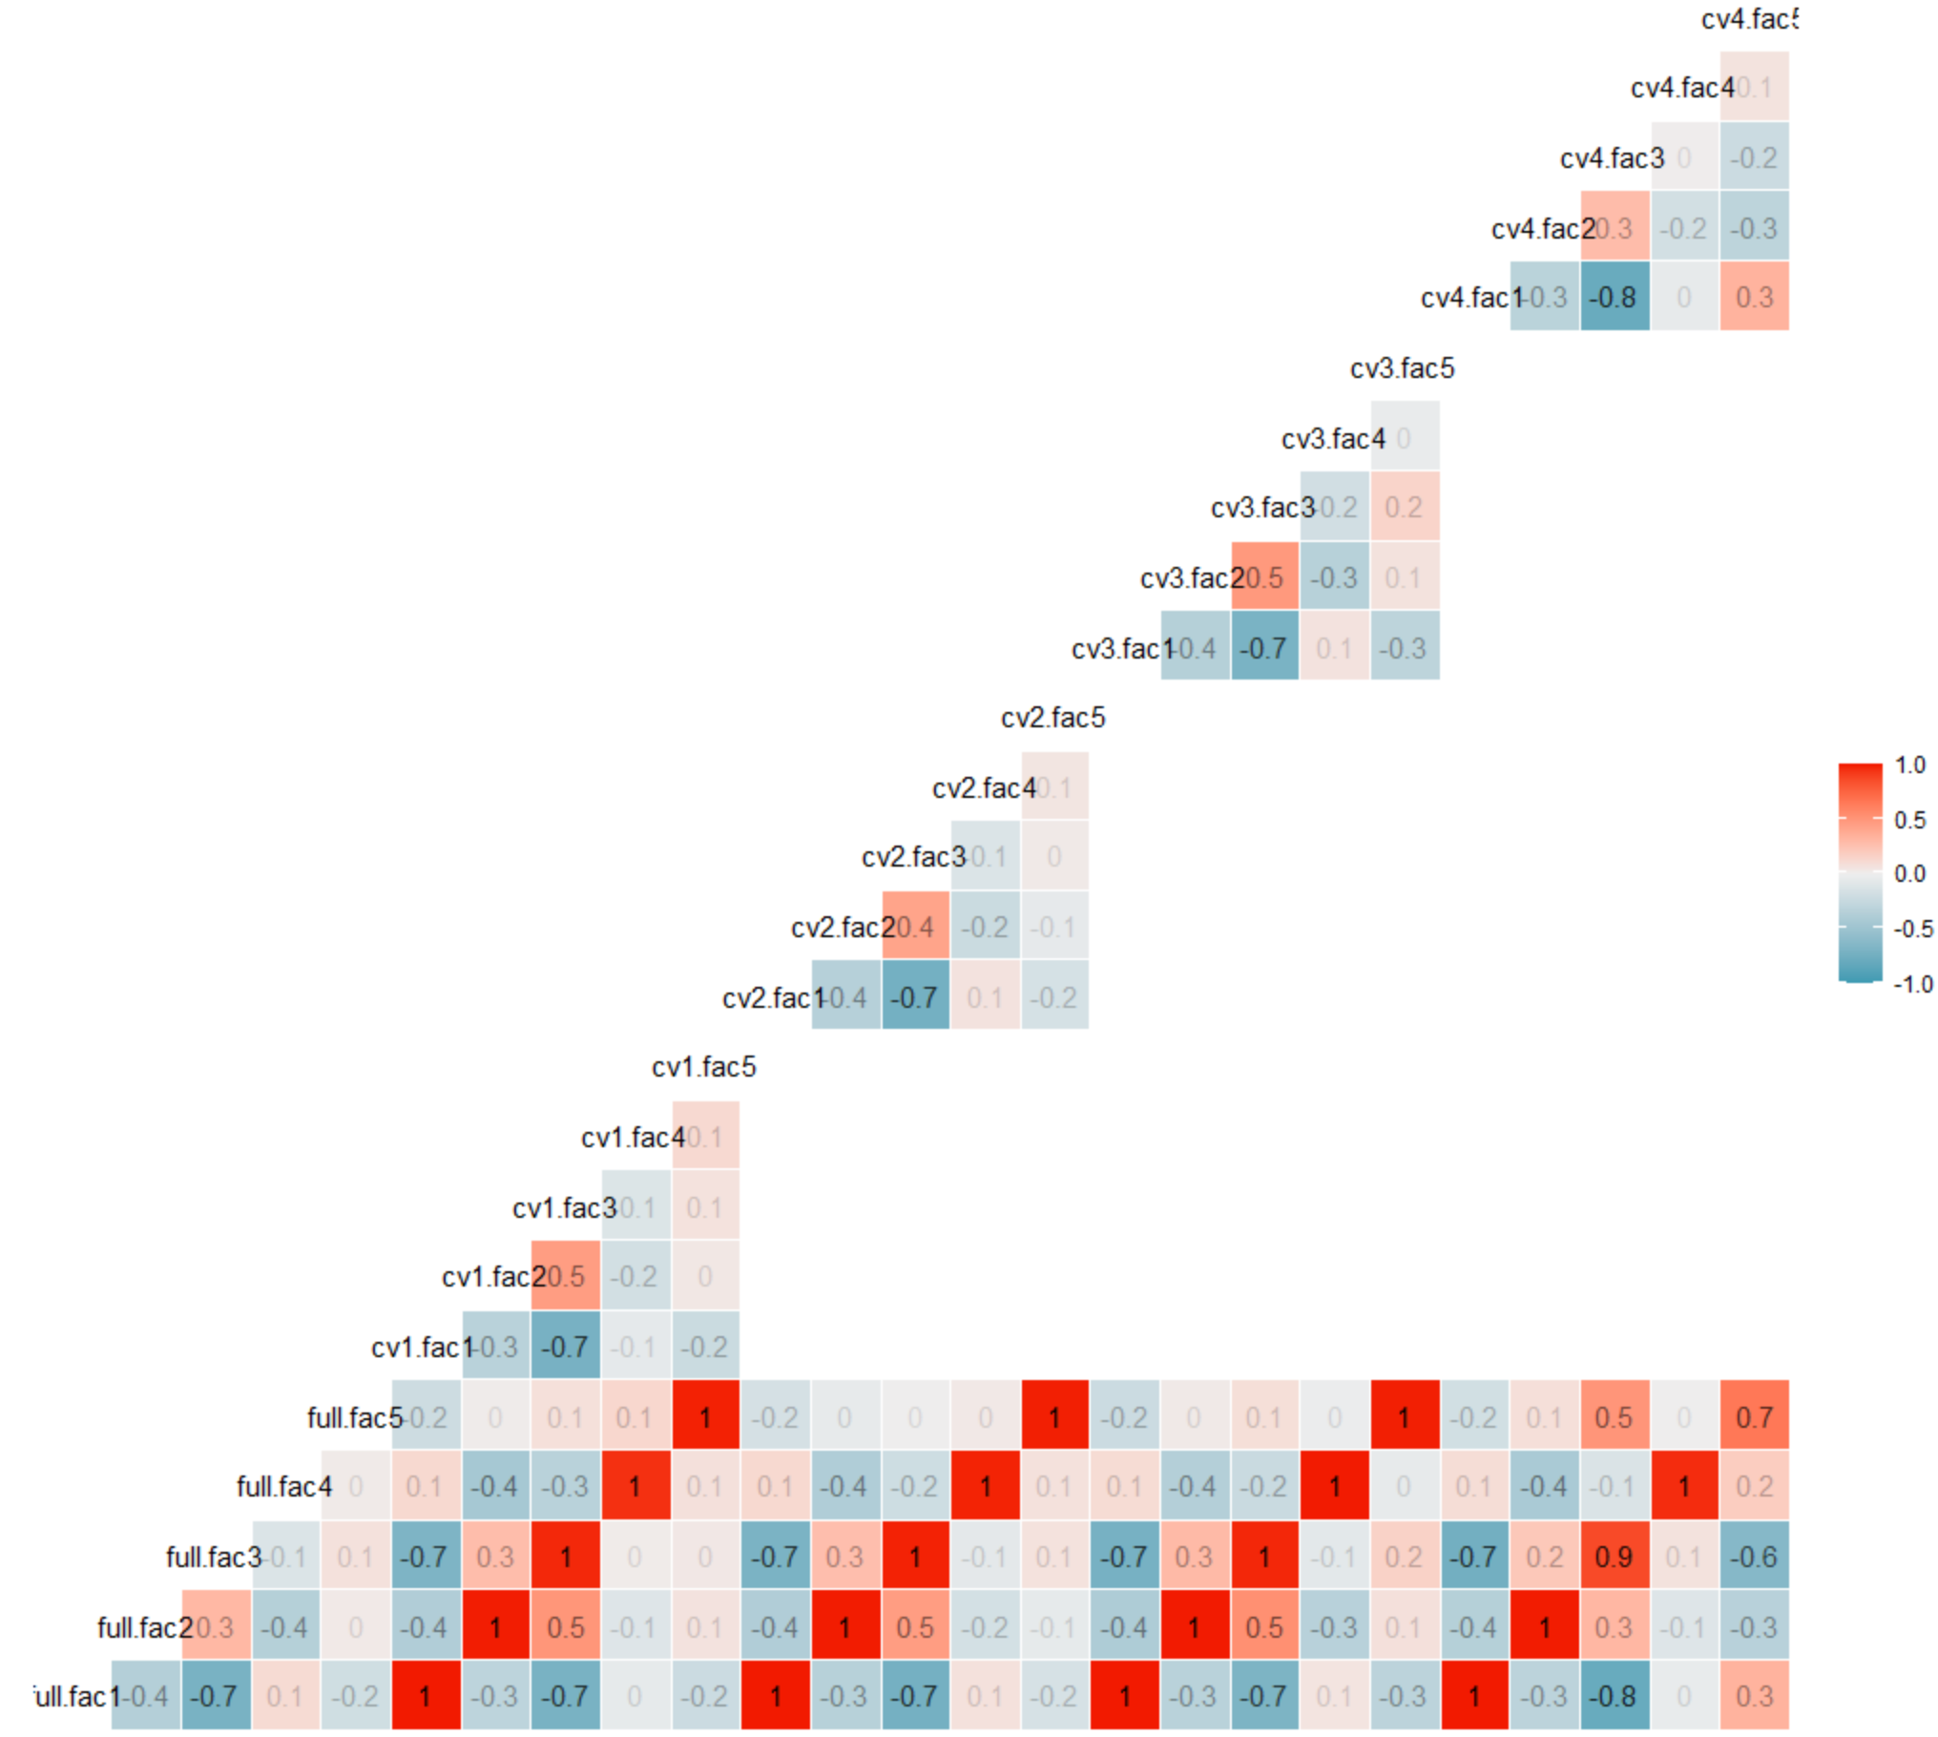
scNMT-seq Comparison plot correlations
Note there are some cross-factor correlations
scRNA

Slide 32
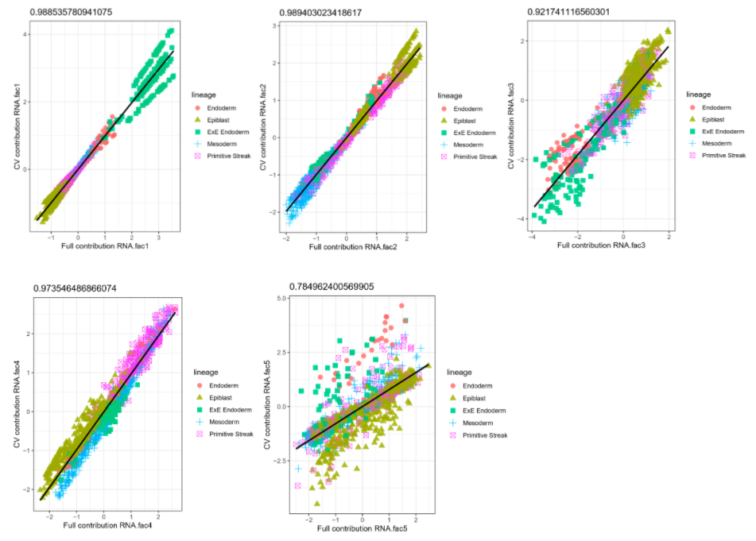
Consistency again strong for scRNA for all 5 factors
We call these “comparison plots”: CV contributions over the contributions from the full data, for scRNA-seq.

Slide 33
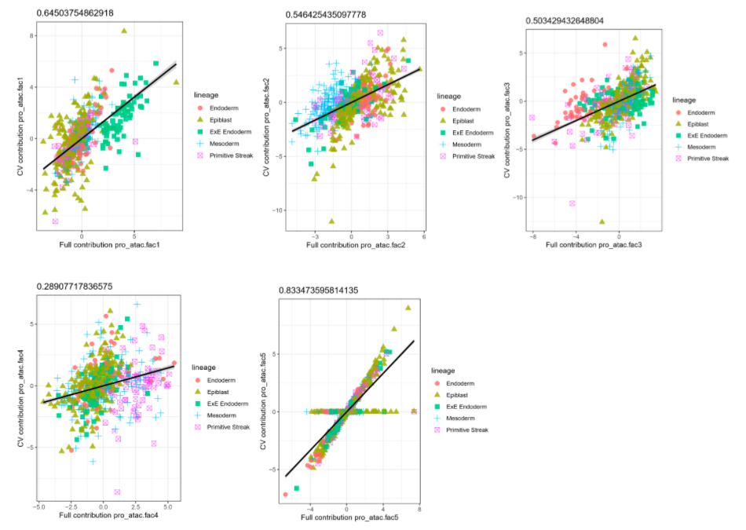
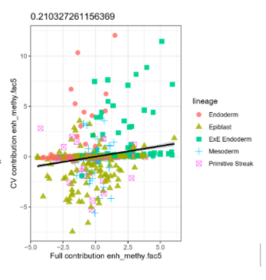
Here, promoter ATAC mostly consistent
Factor #5 in enhancer methyl.
Not as consistent
One fold gets 0’s

Slide 34
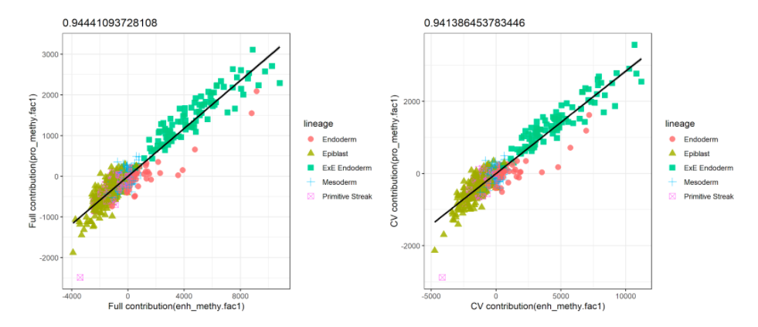
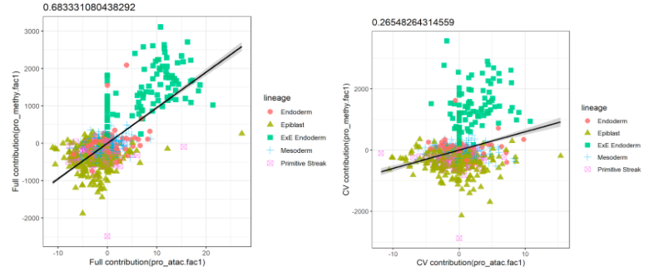
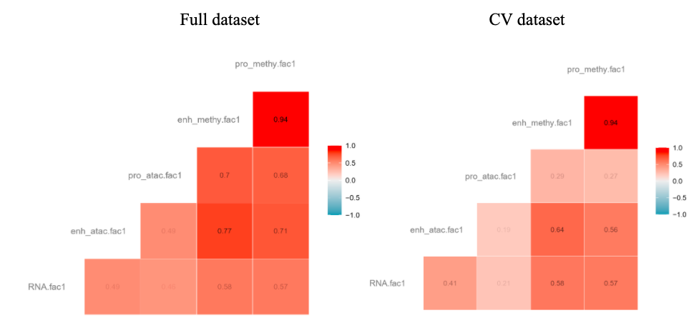
Factor 1

Slide 35
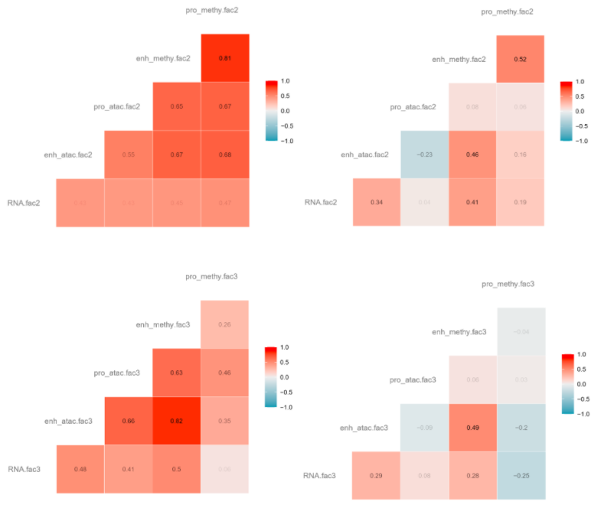
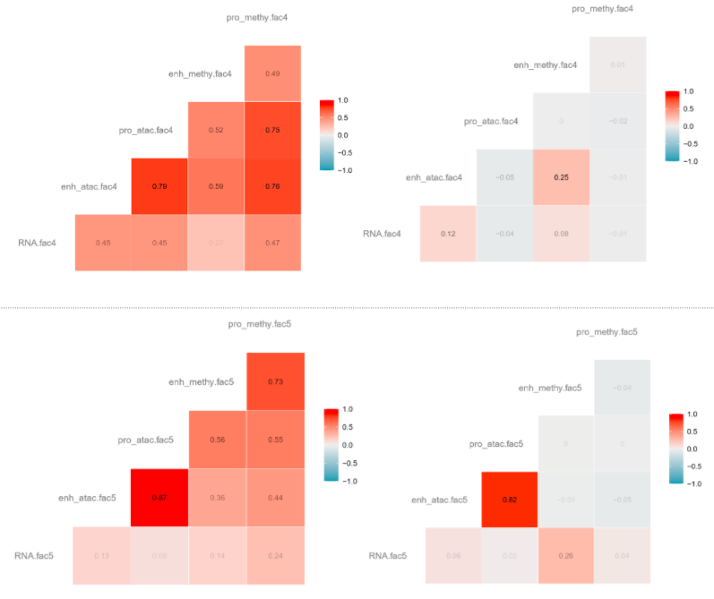
Factor 2
Factor 4
Factor 3
Factor 5

Slide 36
Conclusions so far
In our hands, Sparse mCCA and MOFA(+) don’t overfit too much
Multi-modal data provide a big search space, lots of opportunity to overfit
We like to see correlations / likelihoods in held-out data
Correlations with linear projections easy and fairly fast to evaluate with CV, non-linear perhaps more difficult using this framework
We have plenty of samples and cells, except some lower factors may be driven by pairs of modalities that may be too sparse for this type of evaluation
Automation of matching may be an interesting problem (e.g. run basic CCA on top of the latent factor matrices)

Slide 37
Acknowledgments
Sean McCabe
Danyu Lin
Wancen Mu
Min-Zhi Jiang
Laura Raffield
Yun Li
Funding:
The work of SDM was supported by National Institutes of Health grant [T32 CA106209-12]
The work of DYL was supported by NIH grants [P01 CA142538, R01 HG009974]
The work of MIL was supported by NIH grants [R01 HG009125, P01 CA142538, P30 ES010126]
Bulk assessment
Multi-omics methods list:
github.com/mikelove/awesome-multi-omics
SC assessment
MESA / TopMed

